Slide 1

Problem Number 5

Slide 2
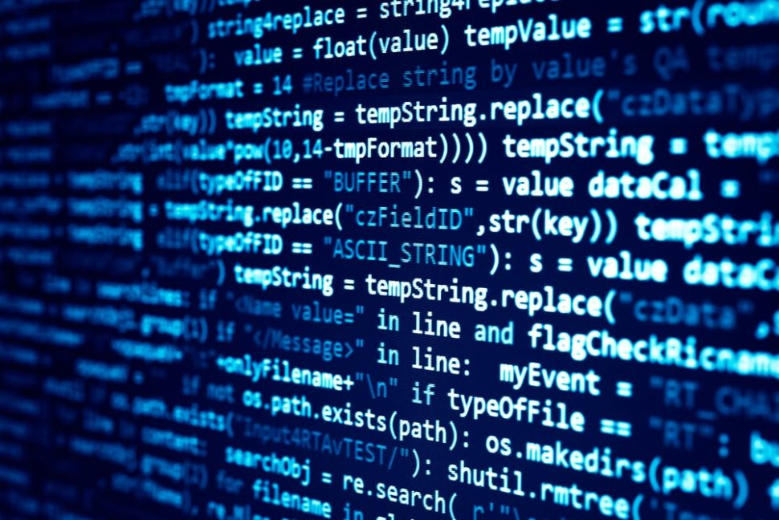
Problem Statement
Write A Program That Performs All Arithmetic Operations On Two Variables.

Slide 3

Algorithm
Step1: Get Two Number From User
Step2: Perform Addition On Two Number And Display To User
Step3: Perform Subtraction On Two Number And Display To User
Step4: Perform Multiplication On Two Number And Display To User
Step5: Perform Division On Two Number And Display To User
Step6: Perform Modulus On Two Number And Display To User
End

Slide 4

Assignment
Write A Program That Performs All Arithmetic Operations On Three Variables.

